Slide 1

7th Grade Accelerated Math
Unit 1, Lesson 4 Solving Two-Step Equations Volume 1, pg. 24

Slide 2


Benchmark
MA.7.AR.2.2
Write and solve two-step equations in one variable within a mathematical context or real-world context, where all terms are rational numbers
volume 1, pg. 24

Slide 3
Integrated Mathematical Thinking and Reasoning Standards
MA.K12.MTR.1.1 Actively participate in effortful learning both individually and collectively.
MA.K12.MTR.2.1 Demonstrate understanding by representing problems in multiple ways.
MA.K12.MTR.4.1 Engage in discussions that reflect on the mathematical thinking of self and others.
MA.K12.MTR.5.1 Use patterns and structure to help understand and connect mathematical concepts.
MA.K12.MTR.7.1 Apply mathematics to real-world contexts.
volume 1, pg. 24

Slide 4

Learning Targets
I can solve two-step equations in one variable.
I can relate the solution of an equation representing a real-world context to the context.
volume 1, pg. 24

Slide 5

Warm-Up
volume 1, pg. 25

Slide 6
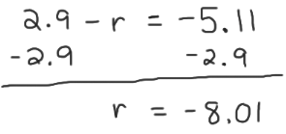
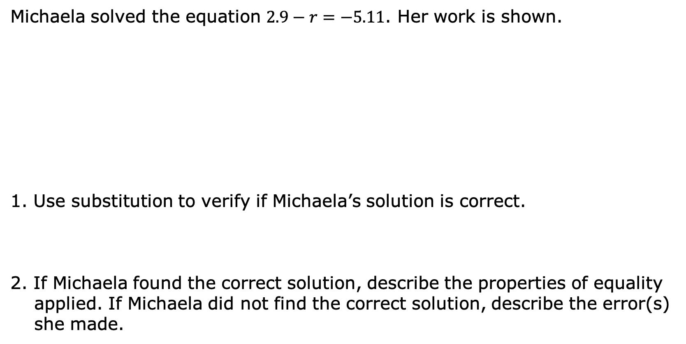
1.4.1 Warm-Up: Bell Work
Michaela solved the equation $2.9−r=−5.11$. Her work is shown.
1. Use substitution to verify if Michaela’s solution is correct.
2. If Michaela found the correct solution, describe the properties of equality applied. If Michaela did not find the correct solution, describe the error(s) she made.
volume 1, pg. 25

Slide 7

Collaboration
volume 1, pg. 25

Slide 8

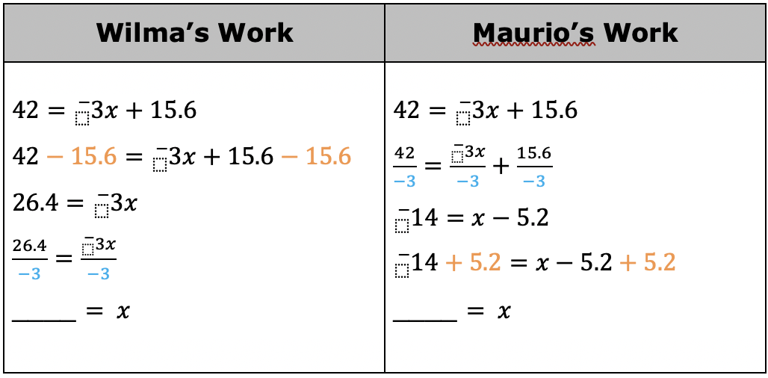
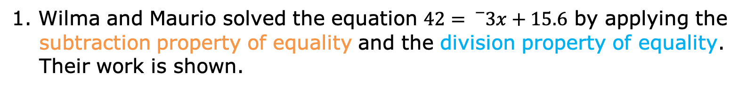
1.4.2 Collaboration: Examining Student Work
1. Wilma and Maurio solved the equation $42={}_{}^{−}{3x}+15.6$ by applying the subtraction property of equality and the division property of equality. Their work is shown.
volume 1, pg. 25

Slide 9
a. Complete the last step in each student’s work. Then, check your work with your partner.
b. Discuss the similarities and differences between each students’ work with your partner. Summarize your discussion in the table.
How are the students’ work similar? | How are the students’ work different?
volume 1, pg. 25

Slide 10
Notice that when division property of equality is applied first, each term in the equation must be divided by the same value to maintain equivalence.
2. Several students made errors when solving equations. Their work is shown in the table.
Work with your partner to find the error in each student’s work. Circle the step where the student made the error. Then, work together to complete the table.
volume 1, pg. 26

Slide 11
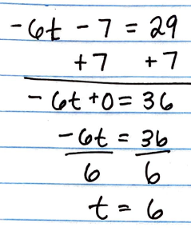
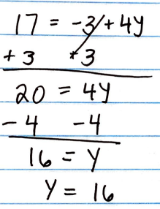
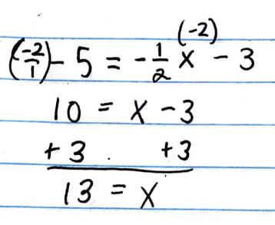
Student Work | Describe the Error | Correct Solution
volume 1, pg. 26

Slide 12

Guided Instruction
volume 1, pg. 26

Slide 13
1.4.3 Guided Instruction: Relating Equations and Their Solutions to Real-World Contexts
Two-step equations can be used to represent real-world situations when solving problems.
Dan’s family recently adopted a dog, so they are putting in a new fence in their backyard. Dan found fencing on sale at a local hardware store, but the store only had 80 linear feet (ft) of the fencing left in stock. Dan knows the backyard is 48.6 ft long and wants to determine how wide the fenced-in portion of the yard would be if he used 80 linear ft of fencing. The dotted line in the figure shows how the fence will be constructed to enclose the backyard.
volume 1, pg. 26

Slide 14
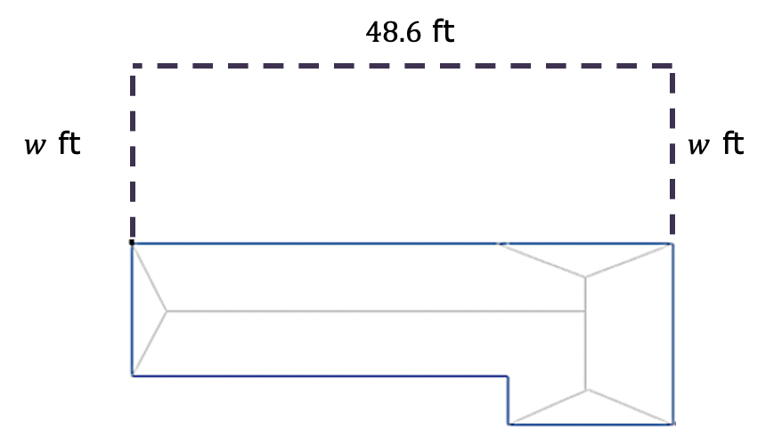
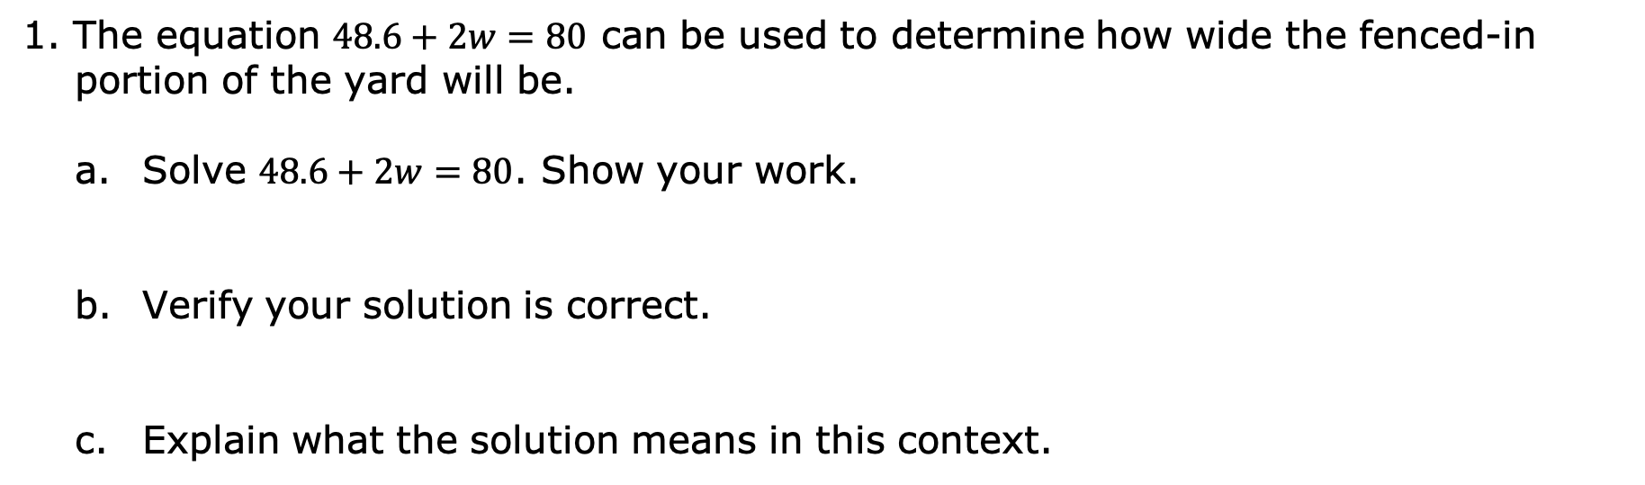
1. The equation $48.6+2w=80$ can be used to determine how wide the fenced-in portion of the yard will be.
Solve $48.6+2w=80$. Show your work.
Verify your solution is correct.
Explain what the solution means in this context.
volume 1, pg. 26

Slide 15
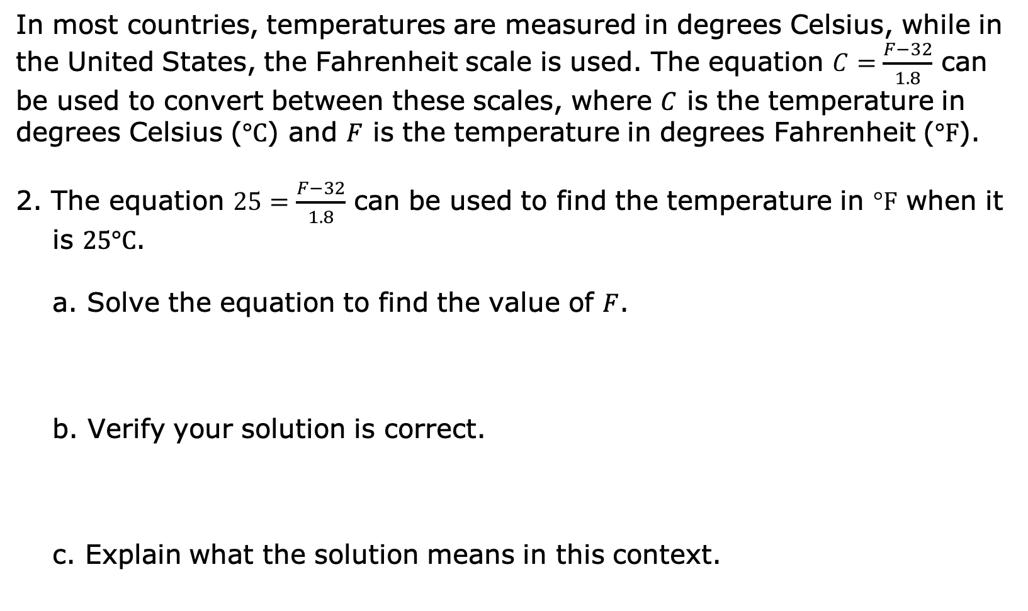
In most countries, temperatures are measured in degrees Celsius, while in the United States, the Fahrenheit scale is used. The equation $C=\frac{F−32}{1.8}$ can be used to convert between these scales, where $C$ is the temperature in degrees Celsius ($°C$) and $F$ is the temperature in degrees Fahrenheit ($°F$).
2. The equation $25=\frac{F−32}{1.8}$ can be used to find the temperature in $°F$ when it is $25°C$.
Solve the equation to find the value of $F$.
Verify your solution is correct.
Explain what the solution means in this context.
volume 1, pg. 27

Slide 16

Your Turn
volume 1, pg. 28

Slide 17
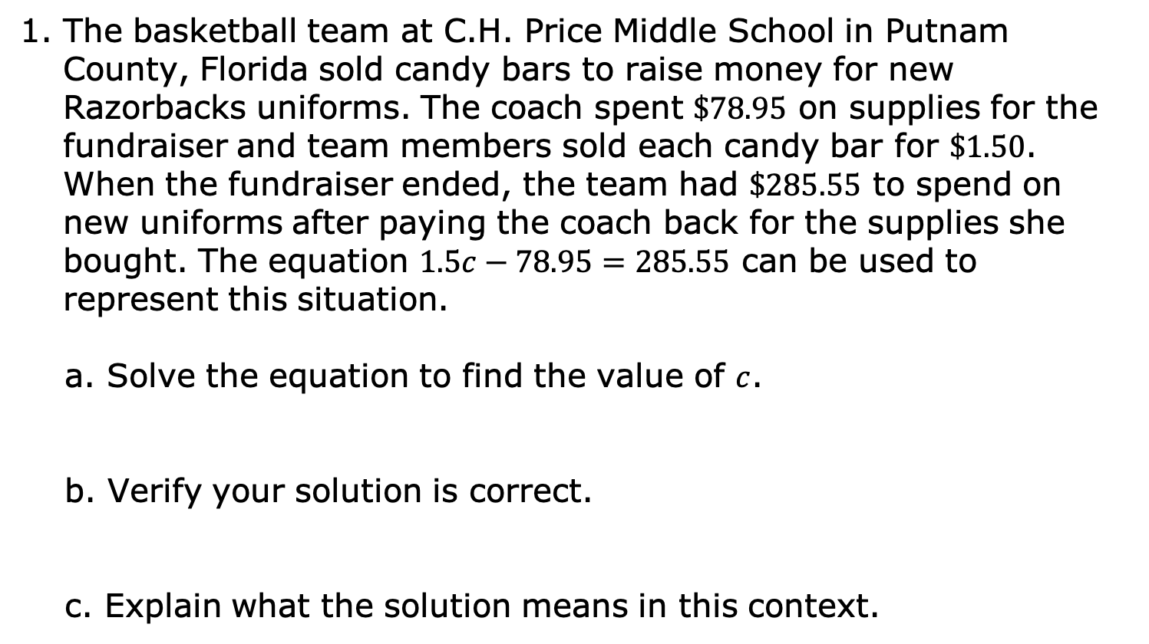
1.4.4 Your Turn!
The basketball team at C.H. Price Middle School in Putnam County, Florida sold candy bars to raise money for new Razorbacks uniforms. The coach spent $\$78.95$ on supplies for the fundraiser and team members sold each candy bar for $\$1.50$. When the fundraiser ended, the team had $\$285.55$ to spend on new uniforms after paying the coach back for the supplies she bought. The equation $1.5c−78.95=285.55$ can be used to represent this situation.
Solve the equation to find the value of $c$.
Verify your solution is correct.
Explain what the solution means in this context.
volume 1, pg. 28

Slide 18

2. Solve $−10\frac{1}{3} + \frac{x}{6} = −\frac{8}{3}$ using the properties of equality. Then, verify your solution is correct.
3. Solve $−9.2=\frac{m+7.22}{4}$ using the properties of equality. Then, verify your solution is correct.
volume 1, pg. 28

Slide 19

Wrap-Up
volume 1, pg. 29

Slide 20
1.4.5 Wrap-Up: Cool Down
Write a summary of what you learned in this lesson.
volume 1, pg. 29

